Slide 1

Course Name: Hardware Security
Faculty Name: Prof Debdeep Mukhopadhyay
Department : Computer Science and Engineering
Topic
Lecture 29: Power Analysis-V

Slide 2

Concepts Covered:
Statistical Analysis of DoM

Slide 3
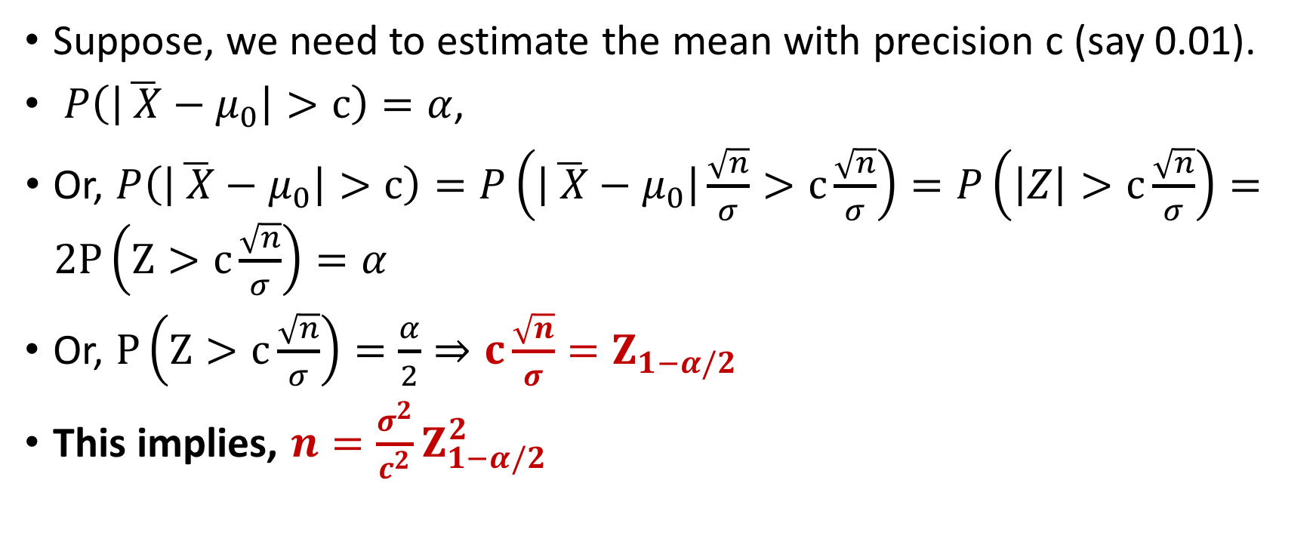

Estimating the Number of Traces to Estimate $μ$
Suppose, we need to estimate the mean with precision c (say 0.01).
$P\left(\left|\overline{ X}−μ_{0}\right|>c\right)=α$,
Or, $P\left(\left|\overline{ X}−μ_{0}\right|>c\right)=P\left(\left|\overline{ X}−μ_{0}\right|\frac{\sqrt{n}}{σ}>c\frac{\sqrt{n}}{σ}\right)=P\left(\left|Z\right|>c\frac{\sqrt{n}}{σ}\right)=2P\left(Z>c\frac{\sqrt{n}}{σ}\right)=α$
Or, $P\left(Z>c\frac{\sqrt{n}}{σ}\right)=\frac{α}{2}⇒c\frac{\sqrt{n}}{σ}=Z_{1−α/2}$
This implies, $n=\frac{σ^{2}}{c^{2}}Z_{1−α/2}^{2}$

Slide 4
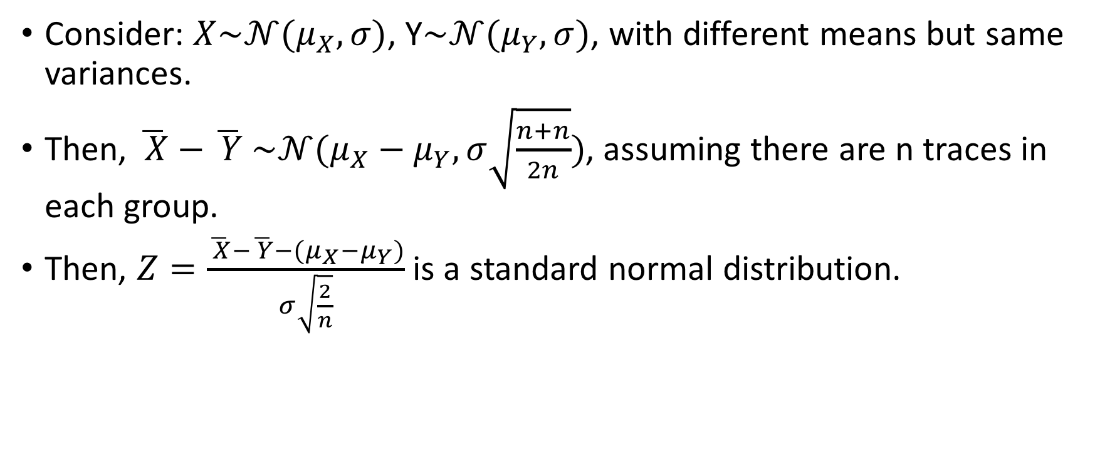
Estimating the number of traces for estimating DoM
Consider: $X\sim 𝒩(μ_{X},σ)$, Y$\sim 𝒩(μ_{Y},σ)$, with different means but same variances.
Then, $\overline{ X}−\overline{ Y}$ $\sim 𝒩(μ_{X}−μ_{Y},σ\sqrt{\frac{n+n}{2n}})$, assuming there are n traces in each group.
Then, $Z=\frac{\overline{ X}−\overline{ Y}−(μ_{X}−μ_{Y})}{σ\sqrt{\frac{2}{n}}}$ is a standard normal distribution.

Slide 5
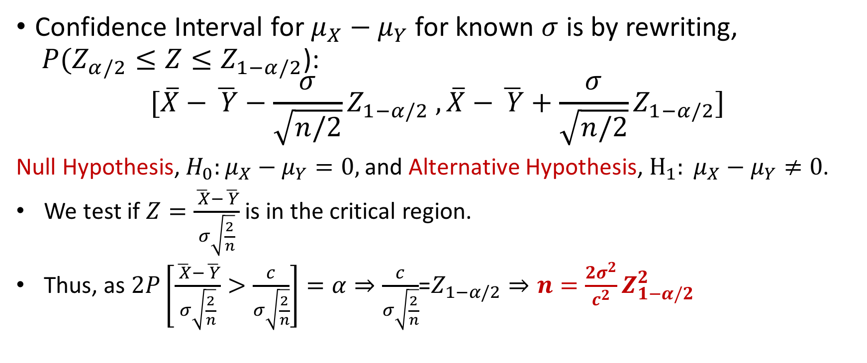
Confidence Interval for DoM
Confidence Interval for $μ_{X}−μ_{Y}$ for known $σ$ is by rewriting, $P(Z_{α/2}≤Z≤Z_{1−α/2}$):
$$[{\overline{X}−\overline{ Y}−\frac{σ}{\sqrt{n/2}}Z}_{1−α/2} ,\overline{X}−\overline{ Y}+\frac{σ}{\sqrt{n/2}}Z_{1−α/2}]$$
Null Hypothesis, $H_{0}:μ_{X}−μ_{Y}=0,$and Alternative Hypothesis, $H_{1}: μ_{X}−μ_{Y}≠0$.
We test if $Z=\frac{\overline{ X}−\overline{ Y}}{σ\sqrt{\frac{2}{n}}}$ is in the critical region.
Thus, as $2P\left[\frac{\overline{ X}−\overline{ Y}}{σ\sqrt{\frac{2}{n}}}>\frac{c}{σ\sqrt{\frac{2}{n}}}\right]=α⇒\frac{c}{σ\sqrt{\frac{2}{n}}}$=$Z_{1−α/2}⇒n=\frac{2σ^{2}}{c^{2}}Z_{1−α/2}^{2}$

Slide 6
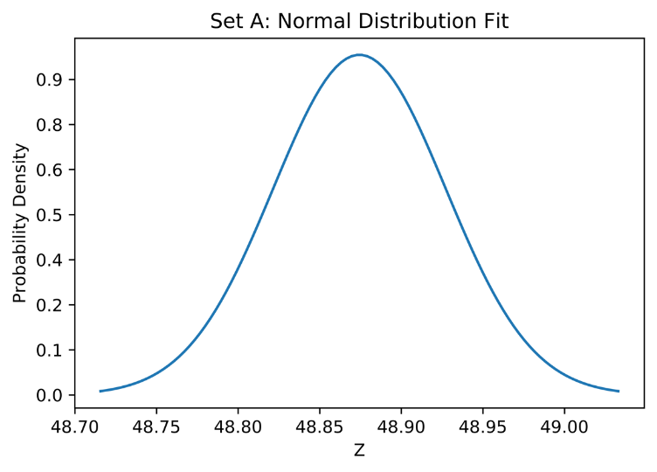
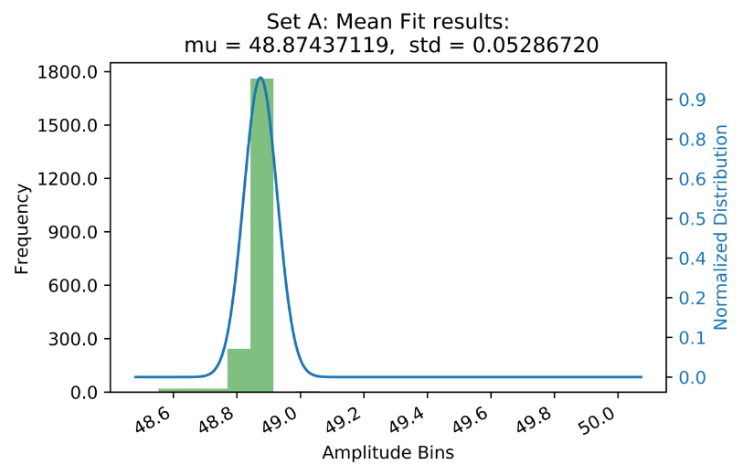
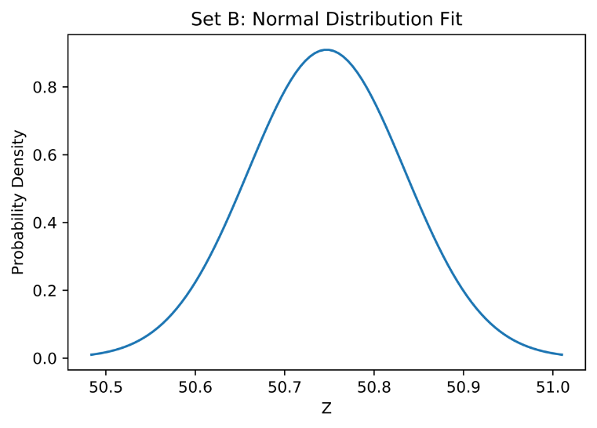
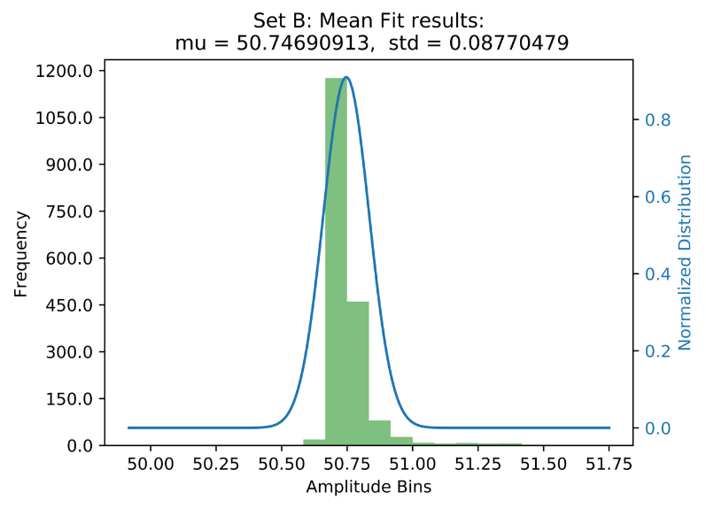
Applying all these to DoM DPA
Set A: refers to target bit 0
Set B: refers to target bit 1.
Sampling Distributions for mean power of the two sets.

Slide 7
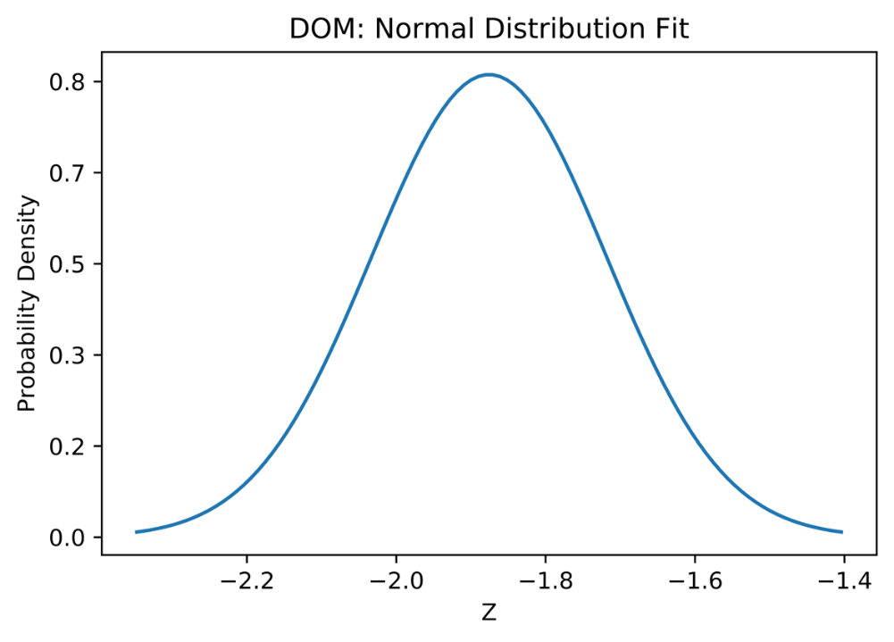
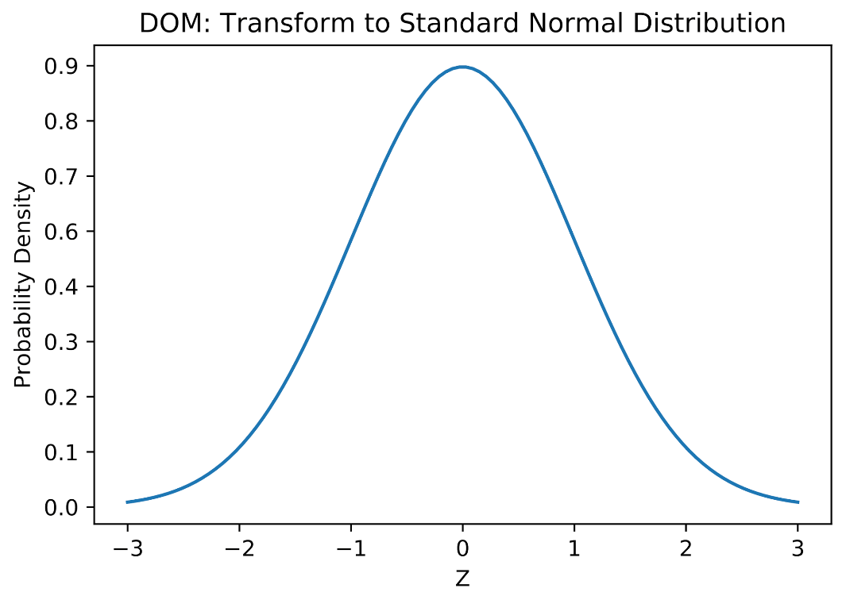
Normal and Standard Normal Curves for DoM
Standardize

Slide 8
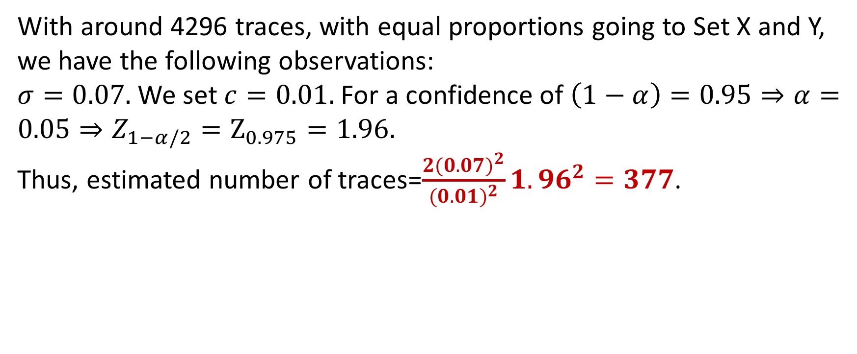
Estimating Number of Traces
With around 4296 traces, with equal proportions going to Set X and Y, we have the following observations:
$σ=0.07.$We set $c=0.01.$For a confidence of $\left(1−α\right)=0.95⇒α=0.05⇒Z_{1−α/2}=Z_{0.975}=1.96.$
Thus, estimated number of traces=$\frac{2{(0.07)}^{2}}{{(0.01)}^{2}}1.96^{2}=377$.

Slide 9
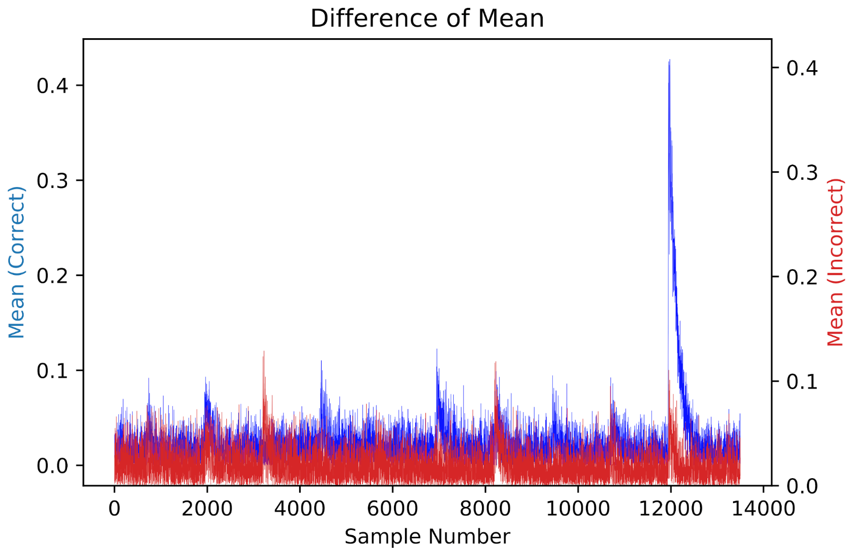
DOM Results Targeting Last Round (all keys)

Slide 10

Stefan Mangard, Elisabeth Oswald, Thomas Popp, Power Analysis Attacks: Revealing the Secrets of Smart Cards

Slide 11
Conclusion:
DPA set-up is crucial to the success of DPA
Noise is an integral component of power traces.
DPA is based on statistical theory:
Use of Hypothesis Testing can help in estimating number of observations required for estimating the parameters needed for an attack with high confidence.

Slide 12


